Slide 1
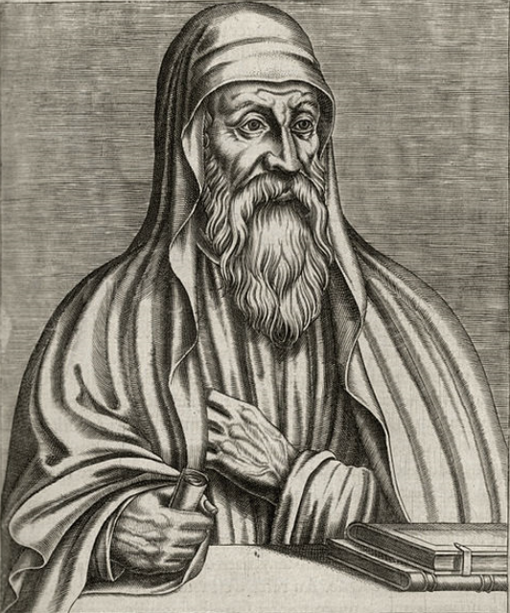
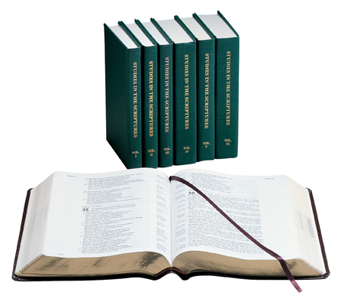
EARLIEST CHURCH FATHERS VIEWS ON CHRONOLOGY COMPARED TO VOLUME 2
ORIGEN
184-253 AD

Slide 2
CONFLICTING SCRIPTURES
Acts 13:20 says
Period of Judges = 450 years
1 Kings 6:1 says
From Exodus to Solomon’s 4th yr = 480 yrs
So how do these texts conflict?

Slide 3
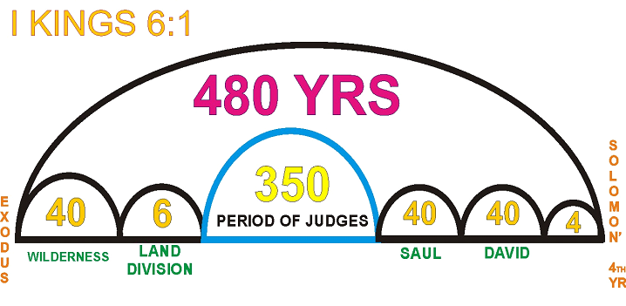
349
The only way to make 1 Kings 6:1 equal 480 years is to shorten the Period of the Judges from 450 down to 349 years.
This is the only formula to make 1 Kings 6:1 work.
Notes:
[After explaining chart] What did Josephus and the Earliest Church Fathers have to say about the Periods of the Judges and 1 Kings 6:1?

Slide 4
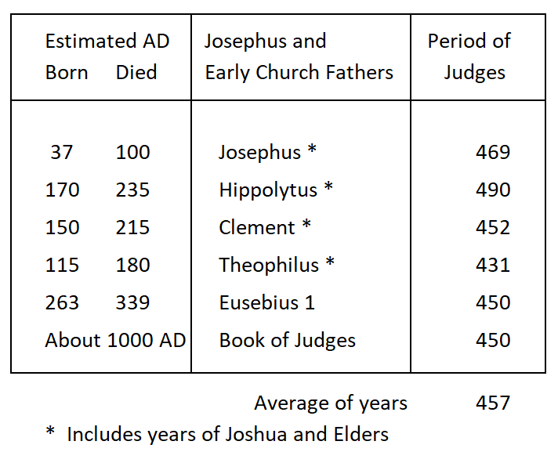
Notes:
In this chart with Josephus and the Earliest Church Fathers, the average of the calculated years for the Period of the Judges is 457 years, which is 108 years greater than the New Chronology amount of 349 years.
None of these early chronologists gave any hint that Judges overlapped each other and that therefore the period would be shorter.

Slide 5
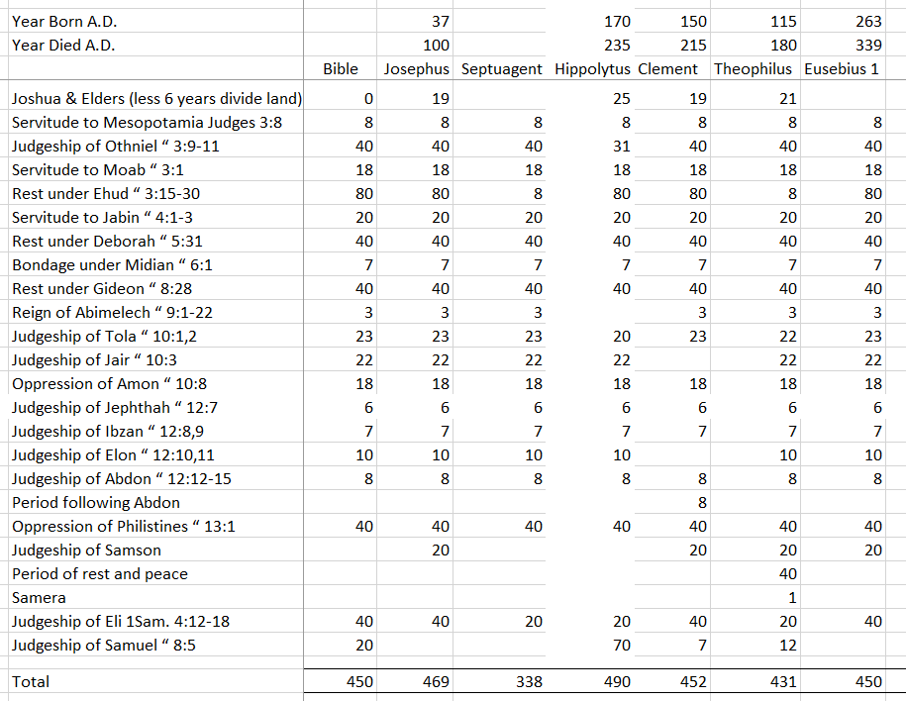
Notes:
This next chart provides the detail of how the amounts from the previous chart were arrived at. I meticulously read through the writings of each of these early Church Fathers and typed in to an Excel spreadsheet the years for each Judge and years of oppressions. I thereby could calculate each of their totals for the Period of the Judges. None of these writers expressed any thought of overlapping judgeships or oppressions.

Slide 6
Should Joshua and the Elders be
included in
or
added to
the 450 years?
Notes:
To stay in sync with Volume 2 chronology, the years until Joshua and the elders died off would need to be included in the Period of the Judges, not added to it.
The typical objection to including this time that Joshua and the Elders died off is that there is seemingly no room to do so... <<

Slide 7
Should Joshua and the Elders be
included in
or
added to
the 450 years?
Notes:
…when adding up the other 450 years listed in the book of Judges. <<
See the “Bible” column total where the red arrow is pointing. It already adds up to 450 years. If we added, lets say 20 years for Joshua and the elders dying off, the 450 years would increase to 470 years. Yet Acts 13:20 says it is 450 years.
Can this problem be solved? Bro. Morten Edgar proposed a solution.

Slide 8
Per Br. Morton Edgar’s article on the Judges, these three periods that add up to 140 years should actually be only 80 years.
Judges 3:15 & 30 (NKJV) “15 But when the children of Israel cried out to the LORD, the LORD raised up a deliverer for them: Ehud the son of Gera…
30 So Moab was subdued that day under the hand of Israel. And the land had rest for eighty years.”
Notes:
Read screen <<
Read verses
Judges 3:30 does not say that Ehud judged Israel for 80 years, it says that the land had rest for 80 years.

Slide 9
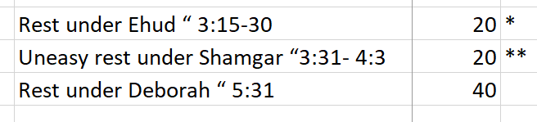
Per Br. Morton Edgar’s article on the Judges, these three periods that add up to 140 years should actually be only 80 years.
* 80 Years of rest would include Ehud, Shamgar, Deborah
** Shamgar was a weak Judge and the highways were not safe during his judgeship (Judges 5:6). In his 20th year he died, then Deborah and Barak delivered Israel from Jabin King of Canaan.

Slide 10
Judges 3:31 (NKJV) “After him [Ehud] was Shamgar the son of Anath, who killed six hundred men of the Philistines with an ox goad; and he also delivered Israel.”
Judges 4:1-3 (NKJV) “1 When Ehud was dead, the children of Israel again did evil in the sight of the LORD. 2 So the LORD sold them into the hand of Jabin king of Canaan, who reigned in Hazor. The commander of his army was Sisera, who dwelt in Harosheth Hagoyim. 3 And the children of Israel cried out to the LORD; for Jabin had nine hundred chariots of iron, and for twenty years he harshly oppressed the children of Israel.”

Slide 11
Judges 5:6-7 (Amplified) “6 After the days of Shamgar son of Anath, after the days of Jael meaning here Ehud the caravans ceased, travelers walked through byways [backroads]. 7 The villages were unoccupied {and } rulers ceased in Israel until you arose--you, Deborah, arose--a mother in Israel.”
Judges 4:1-3 (NKJV) “1 When Ehud was dead, the children of Israel again did evil in the sight of the LORD. 2 So the LORD sold them into the hand of Jabin king of Canaan, who reigned in Hazor. The commander of his army was Sisera, who dwelt in Harosheth Hagoyim. 3 And the children of Israel cried out to the LORD; for Jabin had nine hundred chariots of iron, and for twenty years he harshly oppressed the children of Israel.”
Notes:
After 20 years of harassing Israel under the weak Judge Shamgar, Jabin, King of Canaan saw an opportunity to attack Israel as they had just transitioned to a new Judge, Deborah. Perhaps Jabin miscalculated in thinking that a woman would not be able to lead Israel in a defense against his attack.
<<
To summarize, Ehud 20, Shamgar 20 and Deborah 40.

Slide 12
Should Joshua and the Elders be
included in
the 450 years?

Slide 13
Should Joshua and the Elders be
included in
the 450 years?
YES!
140 years reduced to
80 years of rest equals
-------
60 years for Joshua & the elders
Notes:
Ehud did not judge for 80 years, but rather for only 20 years.
The supposed problem of not being able to include a time period for Joshua and the elders dying off is no longer a problem. Within our 450 year period, we have up to 60 years that can be allocated to Joshua and the elders dying off.

Slide 14
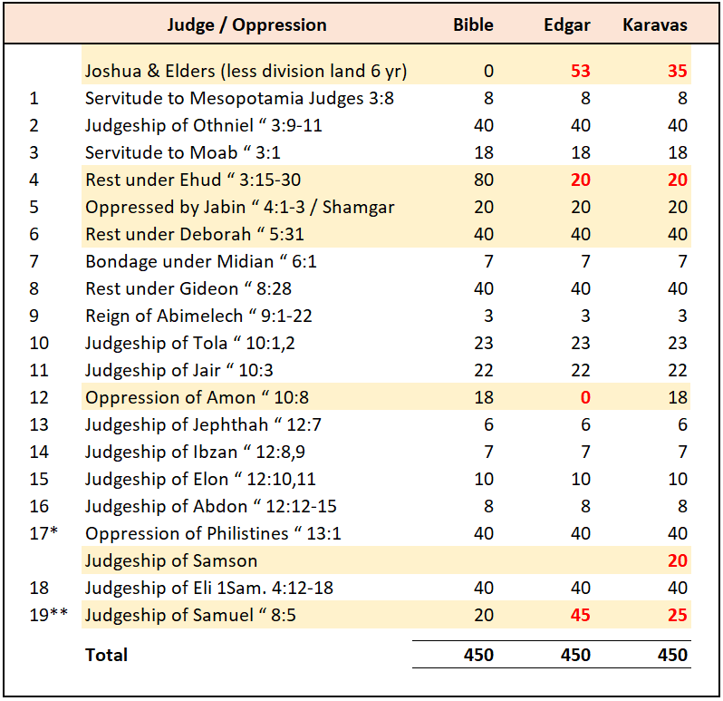
Notes:
Comparison of Standard Bible Assignment with Bros. Edgar and Karavas.
Years are in Red font when Bro. Edgar or Bro. Karavas have a different amount.
Bro. Russell said Judges lapped and tangled.
Conclusion is that there is plenty of room to fit all Joshua, the elders, the Judges and oppressions all in 450 years.

Slide 15
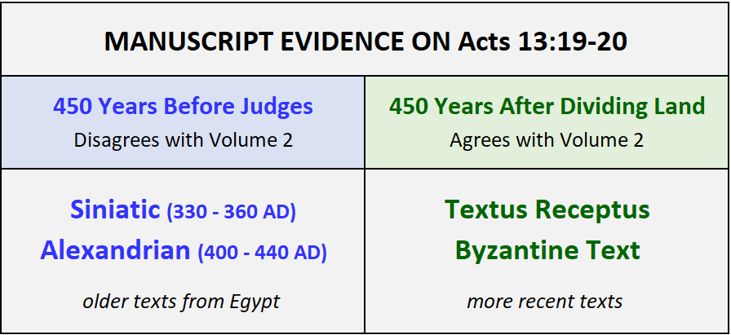
We do not know the reliability or age of the source manuscripts that these manuscripts were copied from.
Notes:
In the left column, the "oldest" surviving manuscripts (those from before the 5th century) which NA/UBS scholars rely on as reliable are all from Egypt. These manuscripts appear to place the 450 years before the Period of the Judges. The manuscripts in the right column are more recent and apply 450 years to the Period of the Judges.
<< Read
Regarding these older manuscripts from Egypt, Origen observed these manuscripts were corrupted.

Slide 16
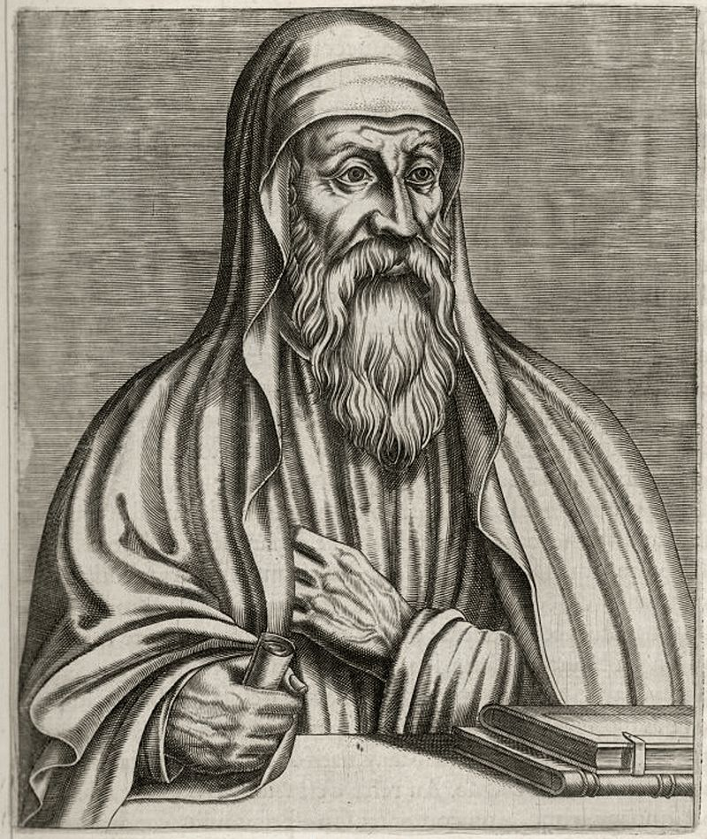
Origen, the Alexandrian church father in the early third century, said:
"...the differences among the manuscripts [of the Gospels] have become great, either through the negligence of some copyists or through the perverse audacity of others; they either neglect to check over what they have transcribed, or, in the process of checking, they lengthen or shorten, as they please."
ORIGEN
184-253 AD
Notes:
Origen is speaking of the manuscripts of his location, Alexandria, Egypt. So by an Alexandrian Church father's own admission, manuscripts in Alexandria by 200 AD were already corrupt. Origen’s most important work on textual criticism was the Hexapla, a comparative study of various translations of the Old Testament. So Origen was very familiar with Biblical text and translation.

Slide 17

Eusebius of Caesarea, Chronicon, Book 1
Page 101: “…The holy Apostle Paul, in his speech to the Jews in the Acts of the Apostles, says as follows [ 13'19-22 ]: "Joshua destroyed seven nations in the land of Canaan, and he divided the land [amongst the Jews] for 450 years… That is what the Apostle says. According to him, there were 534 years after Joshua. As well as the 450 years, which he assigns to the judges until Samuel,”
Notes:
In the early 4th Century, Eusebius would likely have had access earlier manuscripts for Acts 13:20 than exist today, including many manuscripts not from Egypt. It would be hard to imagine that he misread the Greek.

Slide 18
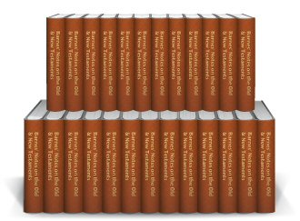
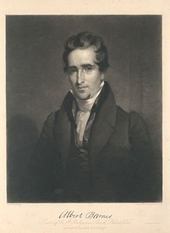
ALBERT BARNS NOTES: Acts 13:20 “About the space of our hundred and fifty years.” This is a most difficult passage, and has exercised all the ingenuity of chronologists. The ancient versions agree with the present Greek text. The difficulty has been to reconcile it with what is said in 1Kings 6:1…
Notes:
Bible Scholar and Commentator Albert Barns admits there are problems with applying the 450 years to the time before the Judges.
Read screen.
Here Albert Barns admits that the difficulty the scholars have, is not with Acts 13:19-20, but rather how to reconcile it with 1 Kings 6:1.

Slide 19
ALBERT BARNS NOTES: Acts 13:20 (continued) Various ways have been proposed to meet the difficulty. Doddridge renders it, “After these transactions, [which lasted] four hundred and fifty years, he gave them a series of judges,” etc., reckoning from the birth of Isaac, and supposing that Paul meant to refer to this whole time. But to this there are serious objections.
1. It is a forced and constrained interpretation, and one manifestly made to meet a difficulty.
2. There is no propriety in commencing this period at the birth of Isaac. That was in no manner remarkable, so far as Paul’s narrative was concerned; and Paul had not even referred to it…
3. There is reason to believe that that which is here mentioned was the common chronology of his time. It accords remarkably with that which is used by Josephus….

Slide 20
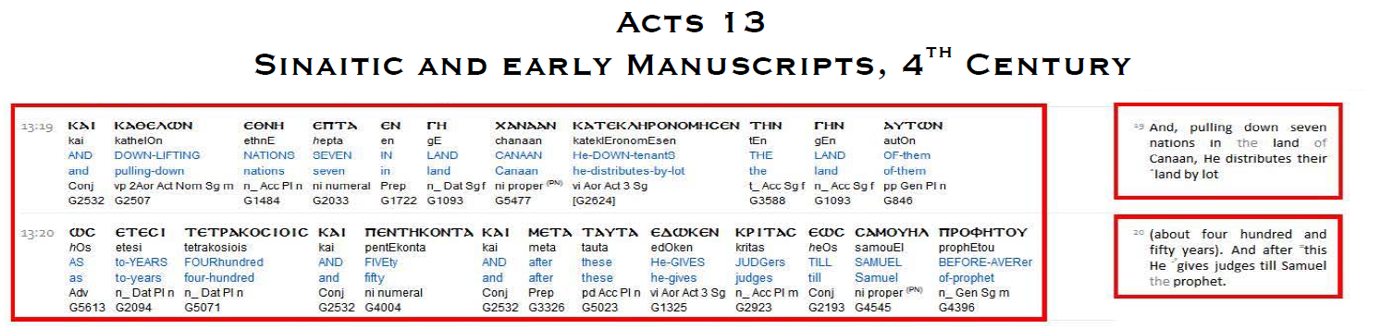
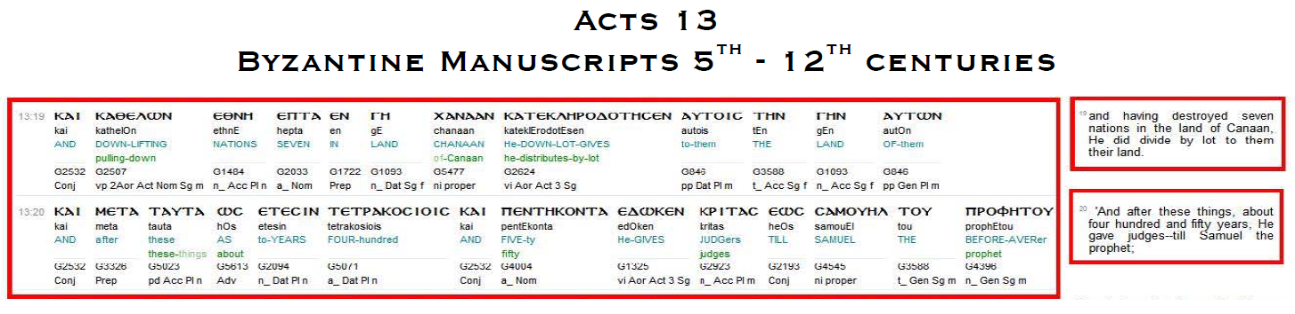
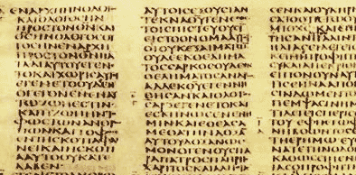
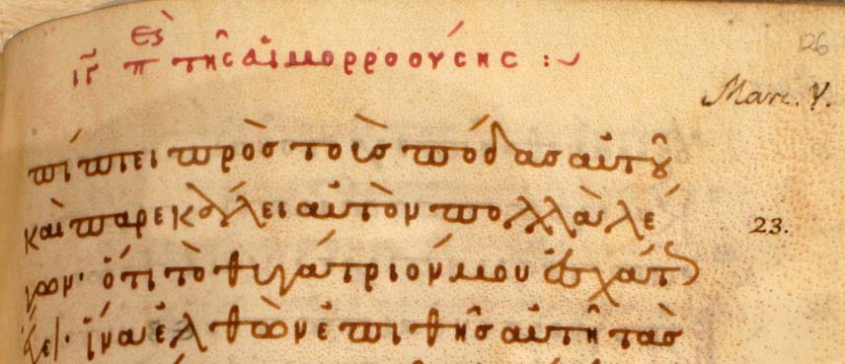
Notes:
We would like to compare the older Egyptian text like the Siniatic with the newer texts like the Byzantine Manuscripts.
Thanks to Br. Jerry Leslies for supplying the screen shot above and the translation on the next screen.

Slide 21

Acts 13:19-21
Earliest Manuscripts:
AND AFTER DESTROYED NATIONS SEVEN IN LAND OF CANAAN HE DISTRIBUTED BY LOT THE LAND OF THEM AS YEARS FOUR HUNDRED AND FIFTY AND AFTER THESE HE GAVE JUDGES UNTIL SAMUEL THE PROPHET.
Later Manuscripts:
AND AFTER DESTROYED NATIONS SEVEN IN LAND OF CANAAN HE DISTRIBUTED BY LOT TO THEM THE LAND OF THEM AND AFTER THESE AS YEARS FOUR HUNDRED AND FIFTY HE GIVES JUDGES UNTIL SAMUEL THE PROPHET.
Notes:
Literal renderings of the Greek. 450 years either before the word “after” or after the word “after.” Notice that it makes no sense that it took 450 years to distribute the land. The distribution of the land took only 6 years.

Slide 22
Acts 13:19-21
Earliest Manuscripts:
AND AFTER DESTROYED NATIONS SEVEN IN LAND OF CANAAN HE DISTRIBUTED BY LOT THE LAND OF THEM AS YEARS FOUR HUNDRED AND FIFTY AND AFTER THESE HE GAVE JUDGES UNTIL SAMUEL THE PROPHET.
NASV: “19 "When He had destroyed seven nations in the land of Canaan, He distributed their land as an inheritance— all of which took about four hundred and fifty years. 20 "After these things He gave them judges until Samuel the prophet.
Notes:
To make sense of the earlier Egyptian manuscripts, many translators like NASV add the words “all of which took” referring to the preceding verses. So there is no way to make sense of the Egyptian texts without adding words not appearing in their text. And where do the commentators take us back to? To the birth of Isaac. Let’s see if the context provides any indication of Isaac.

Slide 23

Acts 13:17-20: (NASV) “17 "The God of this people Israel chose our fathers and made the people great during their stay in the land of Egypt, and with an uplifted arm He led them out from it. 18 "For a period of about forty years He put up with them in the wilderness. 19 "When He had destroyed seven nations in the land of Canaan, He distributed their land as an inheritance - all of which took about four hundred and fifty years. 20 "After these things He gave them judges until Samuel the prophet.
Notes:
If this spurious expression “all of which took” is referring back. What is it referring back to?
Read verses
The context starts in verse 17 with “our fathers.” So it starts with Abraham. When it says, “chose our father,” it was Abraham who was the first chosen father. If they want to arbitrarily start with Isaac, then why no Jacob?

Slide 24

Genesis 18:17-18 (NASV) “17 The LORD said, “Shall I hide from Abraham what I am about to do, 18 since Abraham will surely become a great and mighty nation, and in him all the nations of the earth will be blessed? 19 “For I have chosen him, so that he may command his children and his household after him to keep the way of the LORD by doing righteousness and justice…”
Notes:
Here is confirmation that the first chosen father was Abraham.
Read verse

Slide 25
Acts 13:17-20: (NASV) “17 "The God of this people Israel chose our fathers and made the people great during their stay in the land of Egypt, and with an uplifted arm He led them out from it. 18 "For a period of about forty years He put up with them in the wilderness. 19 "When He had destroyed seven nations in the land of Canaan, He distributed their land as an inheritance— all of which took about four hundred and fifty years. 20 "After these things He gave them judges until Samuel the prophet.
Notes:
And that is what we find here in Acts 13. That’s where Paul’s discussion starts. With Abraham.
So let’s do the math ourselves to see how these scholars arrive at Isaac instead of Abraham.

Slide 26
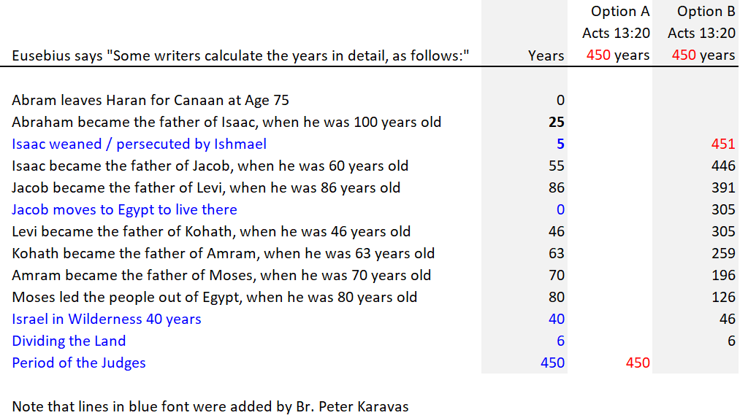
Notes:
In the first column is an enumeration from Eusebius which lists Israel’s fathers from Abraham to Moses and then to the dividing of the Land. If we look at the last column, option B and count backwards in time 450 years, we actually have to count 451 years to get to Isaacs birth. Isaac is not Abraham and Isaac is not mentioned or hinted at in the context of Acts 13. If you are worried about whether or not we can trust Eusebius enumeration, no worries.

Slide 27
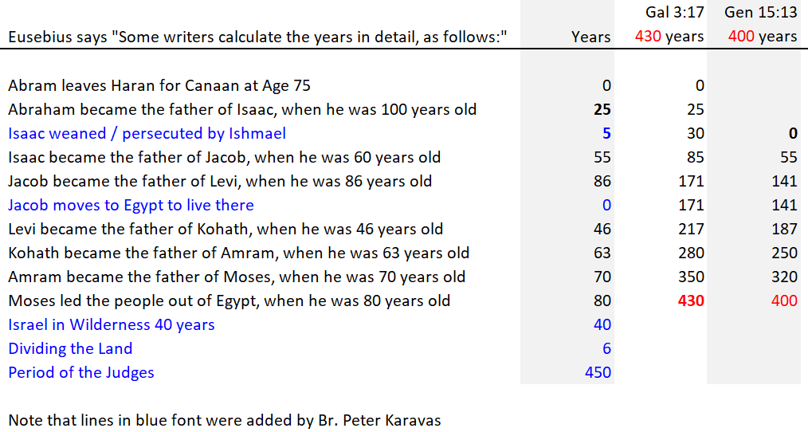
Eusebius “Years” reconciled to the 430 years of Galatians 3:17 and the 400 years of Genesis 15:13
Notes:
Again in the first column is Eusebius count of years from Abraham to the Judges. Did Eusebius get this right or is there a mistake?
With the next two columns we perform an accounting reconciliation by taking the 430 years of Galatians 3:17 and the 400 years of Genesis 15:13 to see if the Bible periods reconcile to Eusebius list. We find that they do. So we are working with the correct count of years and this verifies that you have to go back 451 years to get to Isaac's birth.

Slide 28
Notes:
We see that by the manner in which these earliest Church Fathers tabulated the Biblical data brings us close to 450 years for the Period of the Judges and no where close to 349 years.
None of these early chronologists gave any hint that Judges overlapped each other and that therefore the Period of the Judges would be shorter.

Slide 29
1 Kings 6:1: (KJV) “It came to pass in the four hundred and eightieth year after the children of Israel were come out of the land of Egypt, in the fourth year of Solomon’s reign over Israel, in the month of Zif, which is the second month, that he began to build the house of the LORD.”

Slide 30
349
The only way to make 1 Kings 6:1 equal 480 years is to shorten the Period of the Judges from 450 down to 349 years.
Notes:
.

Slide 31
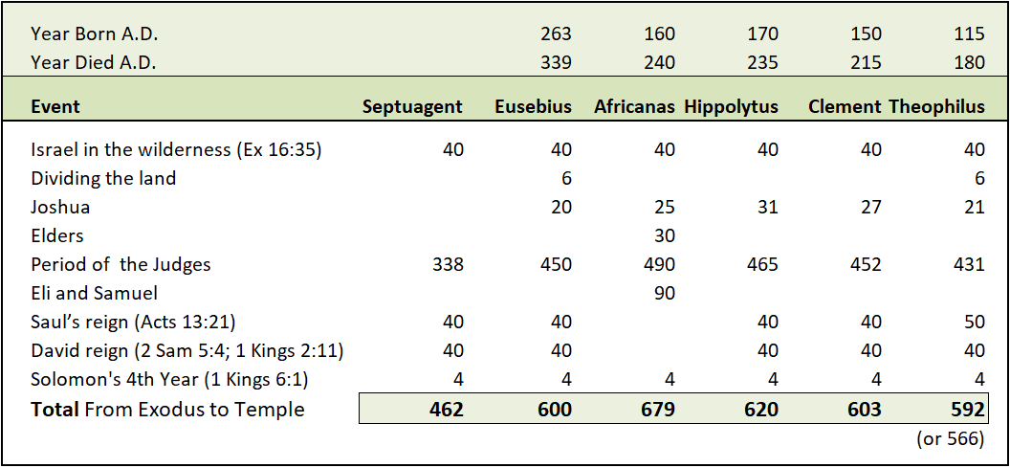
Early writers not in agreement with 480 years of 1 Kings 6:1
Except for Septuagint, early writer figures add up to around 600 years, not 480 years.
Notes:
How can this be? Why did these Earliest Church Fathers seemingly ignore 1 Kings 6:1 which says 480 years?

Slide 32
Origen quotes 1 Kings 5:17-6:1 as:
“The king commanded and they brought great stones, costly stones, and hewed stones, to lay the foundation of the house. Solomon’s builders and Hiram’s builders did hew them and the
stonesquarers: so they prepared timber and stones to build the house. And it came to pass
(in the four hundred and eightieth year after the children of Israel were come out of the land of Egypt) in the fourth year of Solomon’s reign over Israel, in the month Zif, which is the second month, that he began to build the house of the LORD.”
ORIGEN
184-253 AD
Notes:
Origen actually quotes 1 Kings 6:1 and omits the 480 years which we have added and crossed out on the screen for clarity. So we will read it and skip over the crossed out words since those words are not Origen’s words.
Read quote

Slide 33
Early Chronologists on 1 Kings 6:1
There are no surviving Hebrew manuscripts of 1 Kings 6:1 that date back to the early centuries of the Christian Era.
Earliest writers concerned with chronology make no reference to the 480 years of 1 Kings 6:1.
Most refer to the period in 1 Kings 6:1 as about 100 years greater than 480 years.
Notes:
Read screen
The Dead Sea Scrolls do not contain 1 Kings 6:1. The Aleppo Codex and the Leningrad Codex are the oldest complete versions, written by the Masoretes in the 10th and 11th centuries, respectively. So the oldest manuscript evidence of 480 years in 1 Kings 6:1 is from the 10th century.

Slide 34
Early Chronologists on 1 Kings 6:1
Origen quotes 1 Kings 6:1, WITHOUT the words ‘in the four hundred eightieth year”
Theophilus gives the period as 566 or 592 years, yet he makes no reference to the supposed 480 years of 1 Kings 6:1.

Slide 35
Early Chronologists on 1 Kings 6:1
Clement observed that the majority of chronologists recorded this period between 576 and 595 years, yet he makes no reference to the supposed 480 years of 1 Kings 6:1.
Josephus identifies this period as being 594 years.
Notes:
Read screen
How is it possible that several early chronologists estimated between the time from the Exodus to Solomon’s 4th year to be between 566 and 595 years if at the time they could clearly read that 1 Kings 6:1 said 480 years? Brethren, I believe the answer is that the reference to 480 years in 1 Kings 6:1 is a forgery. How It could be remotely possible that all these early chronologists would have missed the reference to 480 years in 1 Kings 6:1 if it were really there in the first place?

Slide 36
1 Kings 6:1
Do you believe that early Chronologists never read 1 Kings 6:1?
Notes:
Let’s consider the Back to the Future illustration. Imagine that Doc Emit Brown picks you up in his DeLorean and takes you back in time to the days of the Early Church Fathers. You meet in a room together with Hippolytus, Clement, Theolphilus, Origen Josephus and the other chronologists that Clement referred to. You ask, “what are you guys thinking?”
You quote 1 Kings 6:1. “How can you be saying around 580 years when 1 Kings 6:1 says 480 years?”

Slide 37
1 Kings 6:1
Do you believe that early Chronologists never read 1 Kings 6:1?
Notes:
Clement turns to Theophilus, “Did you miss that one too?” Theophilus responds, “Boy, I must have really had an off day when I was reading 1 Kings.”
Hippolytus exclaims, “I am so embarrassed. The elders back at home are really going to laugh at me.
So is that what we should conclude brethren. That these early chronologists just never noticed 480 years in 1 Kings 6:1?

Slide 38
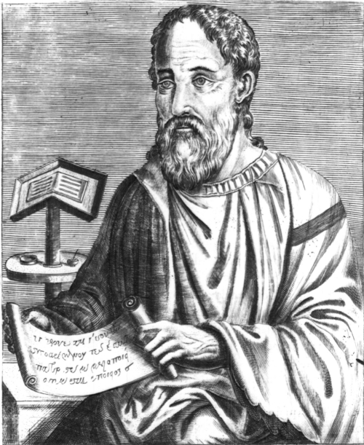
EUSEBIUS
Known as the Father of Church History
Eusebius was bishop of Caesarea Palestine from about A.D. 314 to A.D. 340.
Notes:
We will merely summarize what Eusebius said and those interested can read more detail for yourself at www.BibleChronology.org in the Period of the Judges book.

Slide 39
EUSEBIUS
600 Error: period from Exodus to Solomon’s 4th Year
(Should be 580 years.)
- 40 in the wilderness
27 Joshua plus dividing the land [This is an error as
Joshua should be included in the 450 years below.]
- 40 Saul’s reign
- 40 David reign
- 4 Solomon (to building Temple starting in his 4th yr.)
------
= 450 Agrees with Acts 13:20 for Period of the Judges

Slide 40
EUSEBIUS CALCULATION
600 Exodus to Solomon’s 4th year
-120 Subtract total periods of oppressions
-------
480 Adjusted Exodus to Solomon’s 4th year
(calculation agrees with Jewish Teachers)

Slide 41
EUSEBIUS WROTE
" In the Hebrew version, it says "It happened in the 480th year" because the Jewish teachers, by a careful calculation, decided that the total came to 480 years. They did not count separately the years in which the foreigners are said to have ruled over the people [of Israel], but counted just the time that the judges ruled them, and included within this the periods of foreign domination. And this must be how it is done, because it is the only way that the total can be made to be 480 years….”

Slide 42
EUSEBIUS
6 Division/Conquering of the Land
(not in full control of it)
8 years servitude to king of Mesopotamia
18 years servitude to Moab
20 years servitude to Jabin
7 years bondage under Midian
3 years reign of Abimelech
(oppression by a corrupt King)
18 years period of oppression of Ammon
40 years oppression by the Philistines
-----
120 Total Years
Counting up the years of Oppressions

Slide 43
EUSEBIUS CALCULATION
600 Exodus to Solomon’s 4th year
-120 Subtract total periods of oppressions
-------
480 Adjusted Exodus to Solomon’s 4th year
(calculation agrees with Jewish Teachers)
Do you agree with how the Jewish Teachers arrived at 480 years in 1 Kings 6:1?
Notes:
If you realize that this does not make any sense, then you understand it!

Slide 44

ANOTHER WAY TO CALCULATE 450 YEARS FROM THE BOOK OF JUDGES

Slide 45
Period Years Period Identity, Scripture Reference
59 Judgeship of Joshua and the elders that outlived him
1 8 Servitude to Mesopotamia Judges 3:8
2 40 Judgeship of Othniel “ 3:9-11
3 18 Servitude to Moab “ 3:1
4 80 Rest under Ehud “ 3:15-30 (Jabin in 20th yr & Deborah 40 yr)
5 Servitude to Jabin “ 4:1-3 included above
6 Rest under Deborah “ 5:31 included above
7 7 Bondage under Midian “ 6:1
8 40 Rest under Gideon “ 8:28
9 3 Reign of Abimelech “ 9:1-22
10 23 Judgeship of Tola “ 10:1,2
11 22 Judgeship of Jair “ 10:3
300 (sub-total) Judges 11:26
12 6 Judgeship of Jephthah “ 12:7
13 7 Judgeship of Ibzan “ 12:8,9
14 10 Judgeship of Elon “ 12:10,11
15 8 Judgeship of Abdon “ 12:12-15
16 40 Oppression of Philistines “ 13:1
17 40 Judgeship of Eli 1Sam. 4:12-18
18 45 Judgeship of Samuel “ 8:5
19 -6 Subtract out 6 years for the dividing of the land
450 TOTAL Acts 13:20,21
First 300 years agrees with Judges 11:26
Here is Bro. Morton Edgar’s attempt to add up all the Judges and arrive at 450 years.
Remaining 150 years or so completes the 450 years
Notes:
Br. Mortan Edgar has Judges governing consecutively, with no judges overlapping. Br. Edgar’s study is in the back of the book “Marking Time” at BibleChronology.org.

Slide 46
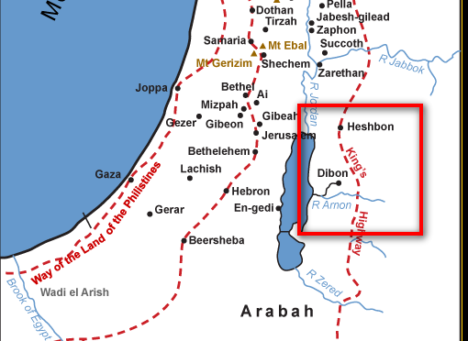
Judges 11:26 ‘While Israel lived in Heshbon and its villages, and in Aroer and its villages, and in all the cities that are on the banks of the Arnon, three hundred years, why did you not recover them within that time? - NASV
Notes:
Jeptha argues with the King of Ammon
Read verse

Slide 47
The New Chronology view overlaps these periods to reduce 156 years to 56 years
Here is what years remain after Jephtha’s 300 years
Period Years Period Identity, Scripture Reference
300 (sub-total) Judges 11:26
12 6 Judgeship of Jephthah “ 12:7
13 7 Judgeship of Ibzan “ 12:8,9
14 10 Judgeship of Elon “ 12:10,11
15 8 Judgeship of Abdon “ 12:12-15
16 40 Oppression of Philistines “ 13:1
17 40 Judgeship of Eli 1Sam. 4:12-18
18 45 Judgeship of Samuel “ 8:5
19 -6 Subtract out 6 years for the dividing
of the land
450 TOTAL Acts 13:20,21
Notes:
Since there were no overlaps in the first 300 years, it would NOT be consistent to create extensive overlapping among the Judges after the 300 years.
Why overlap these periods when they pretty much add up to and agree with the Apostle Paul’s statement of 450 years?

Slide 48
INTERNAL EVIDENCE FROM THE BOOK OF JUDGES
Can the Period of the Judges be shortened to 349 years?
Requirements:
1) Overlapping judgeships
2) Regional judgeships
Notes:
You can’t have two Judges of all Israel at the same time, because that would be like a town having two mayors, or a state having two governors or a country having two presidents.

Slide 49
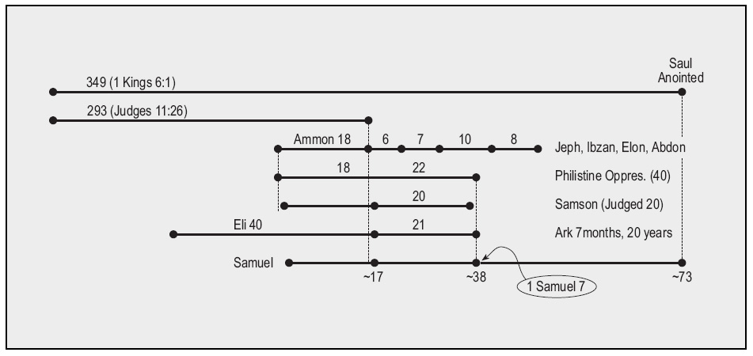
PROPOSED OVERLAPS FOR 349 YEARS

Slide 50
PROPOSED OVERLAPS FOR 349 YEARS
Jephtha, Ibzan & Elon
Samson
Samuel
Can there be three Judges at the same time?

Slide 51
Local Judges?
Othniel - Jg 3:10 - “Judged Israel”
Ehud - Jg 3:15 - “when the children of Israel cried out to the
LORD, the LORD raised up a deliverer”
Deborah - Jg 4:4 – “was judging Israel at that time”
Gideon - Jg 6:14 – “the LORD said,"…you shall save Israel”
Tola - Jg 10:2 – “there arose to save Israel Tola”
Jair - Jg 10:3 – “judged Israel”
Jephthah - Jg 12:7 – “judged Israel”
Ibzan - Jg 12:8 - “judged Israel”
Elon – Jg 12:11 - “judged Israel”
Abdon - Jg 12:13 – “judged Israel”
Samson Jg 15:20 & 16:31 – “judged Israel”
Eli - 1 Sam 4:8 – “judged Israel”
Samuel - 1 Sam 7:15-17 - “judged Israel”
Notes:
There is no scripture in the book of Judges that indicates that any Judge did not preside over the whole of Israel, but only over a mere tribe or geographical area. Every judge on our list is described in the Bible as judging Israel.

Slide 52

S U M M A R Y
Early Church Fathers Chronology best fits Volume 2
450 years for the Judges (not 349)
580 years for Exodus to Temple (not 480)
Origen found the Egyptian manuscripts to be less reliable. They make NO sense unless “all of which took” is added. Even then 450 years does NOT take you back far enough to reach Abraham, the first of the “Fathers.” Hence the 450 years applies to the period of the Judges.
Judges 11:26 demonstrates that the first 300 years of Judges are sequential without overlaps. It is inconsistent to believe that the last 156 years of Judges includes extensive overlaps, shortening the time to 56 years.

Slide 53
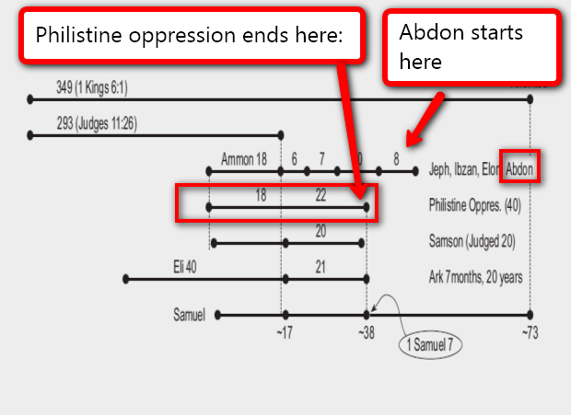
JOSEPHUS’ TESTIMONY:
“After Abdon was dead, the Philistines overcame the Israelites and received tribute of them for forty years.” Antiquities of the Jews, Cha 8, par 1.

Slide 54
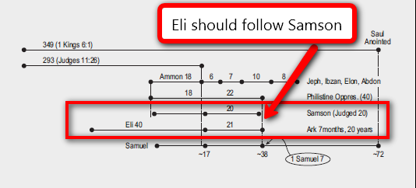
JOSEPHUS TESTIMONY:
“Now after the death of Samson, Eli the high priest was governor of the Israelites.” Antiquities of the Jews, Cha 9, par 1.

Slide 55

Luke 12: (NKJV) 35 "Let your waist be girded and your lamps burning; 36 "and you yourselves be like men who wait for their master, when he will return from the wedding, that when he comes and knocks they may open to him immediately. 37 "Blessed are those servants whom the master, when he comes, will find watching. Assuredly, I say to you that he will gird himself and have them sit down to eat, and will come and serve them.
Notes:
Who is this knocking and serving? This “meat in due season” comes from Jesus, not from Brother Russell. Did Jesus provide the wrong chronology? We Jesus provided the correct chronology.

Slide 57
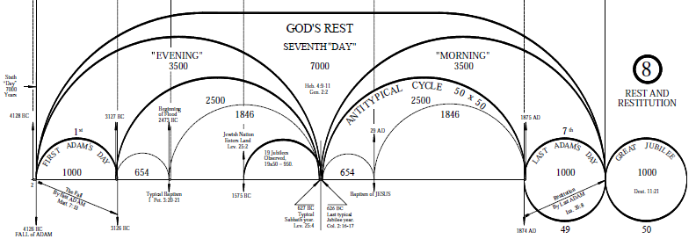
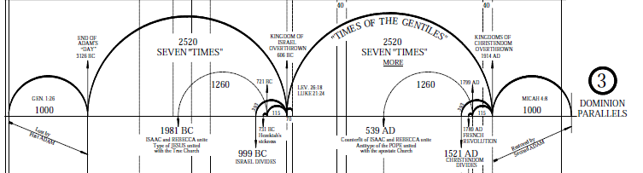
Remarkable Parallels and Time Prophecies confirm Bible Chronology just like a Bank Statement reconciles to the General Leger Cash Account.
Notes:
Notice that these parallels are all locked into a 7,000 year period that begins with the expulsion of Adam from the Garden and ends in 2874. This can only be done with this level of detail, precision and symmetry with Volume 2 chronology. Next time you see impressive sounding alternate time features, ask to view them in this big picture format or see whether they fit or fall apart.

